Slide 1
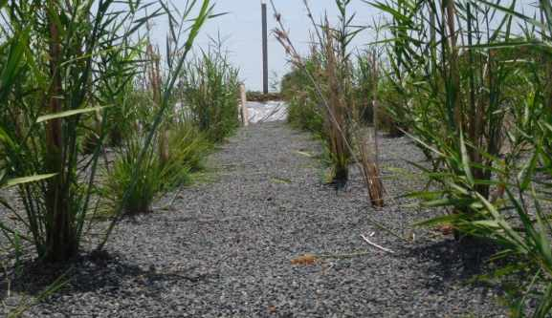
VERTICAL FLOW
CONSTRUCTED WETLAND
TECHNICAL SPECIFICATION AND REQUIREMENTS

Slide 2
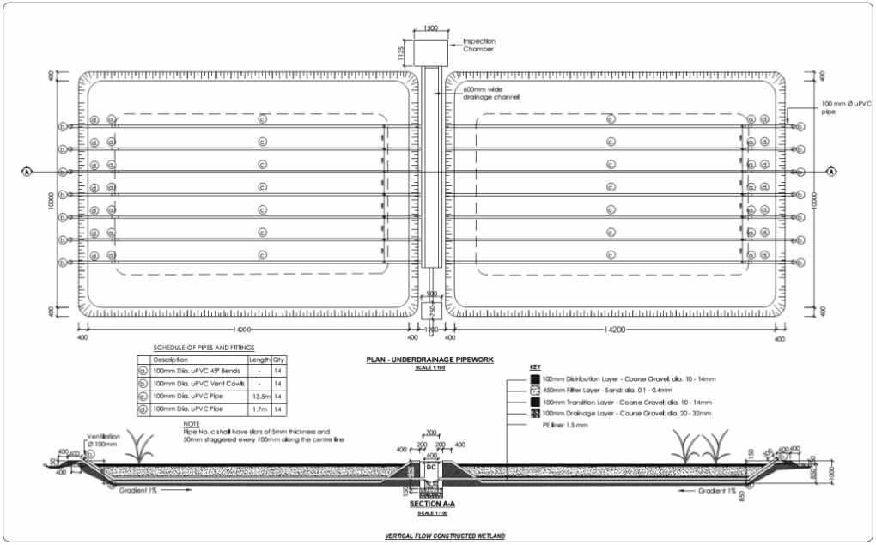

Slide 3
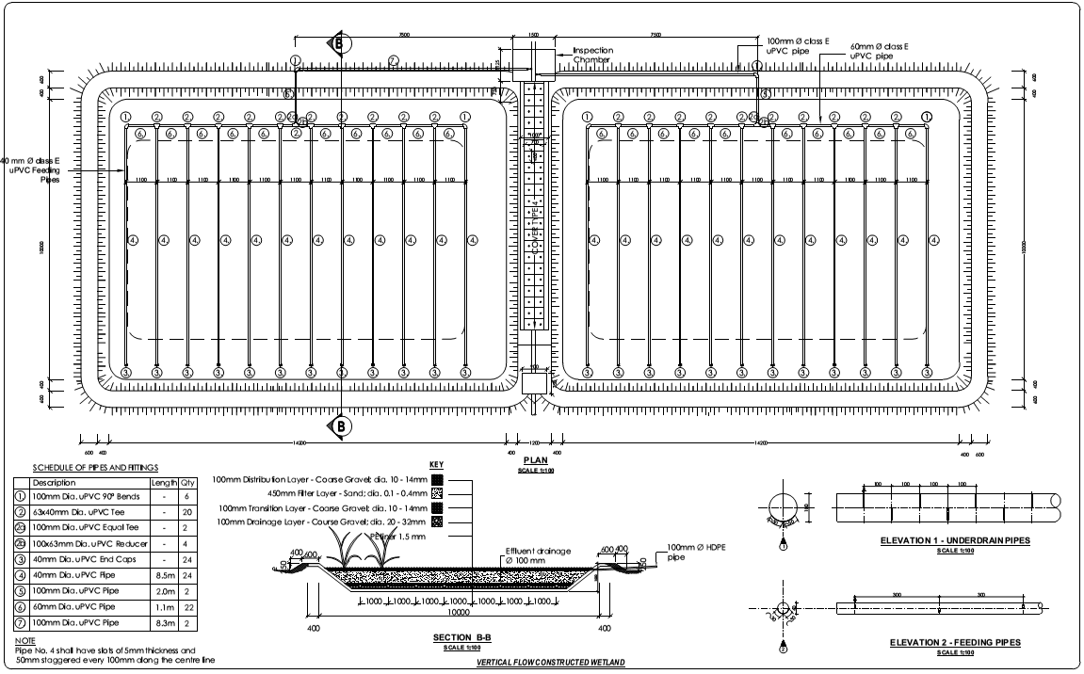

Slide 4
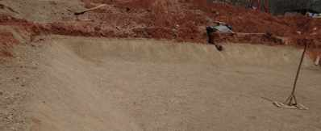
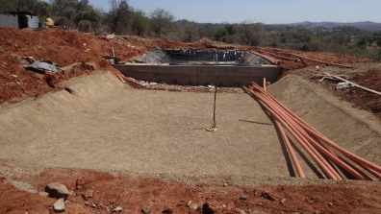
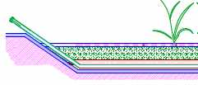
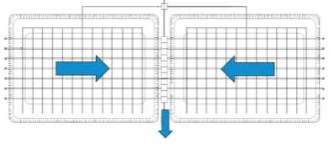
SUBSURFACE
Compact the subgrade (below the filter media) uniformly
A slope of 1% toward the drainage channel is recommended for proper drainage
15 cm freeboard for water accumulation
The surface must be flat and horizontal to prevent unequal distribution and surface run-off
Gradient 1%
Gradient 1%
15 cm

Slide 5
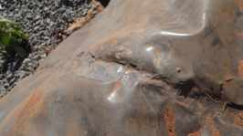
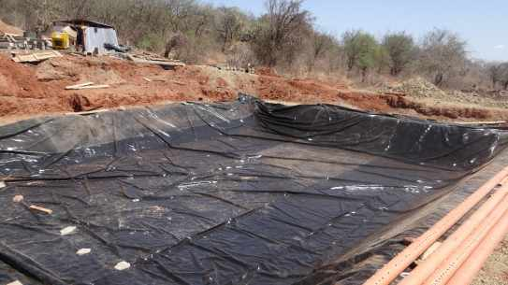
LINING MATERIAL
A clay layer + Plastic liner to seal the filter bed at the base
Clay layer of 100 mm thickness, if no clay available, the soil can be mixed with cement (8kg/m2)
Preparation of the subgrade is crucial for successful liner installation: well compacted, free from materials that might puncture the liner
PE liner 1 mm thick
Overlapping 5 to 10 cm welded with wedge / hot air welding machine
Before filling with gravel, water tightness test of the filter beds

Slide 6
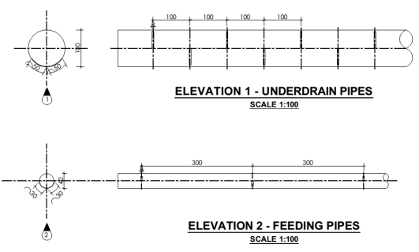
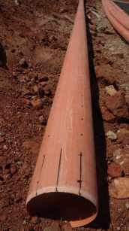
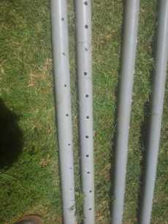
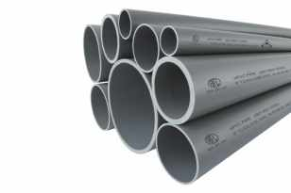
PERFORATION OF PIPES
Feeding pipes: uPVC class E (100, 60 and 40 mm dia.)
Underdrain pipes: uPVC class 41 (100 mm dia)

Slide 7
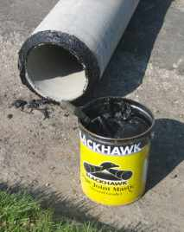
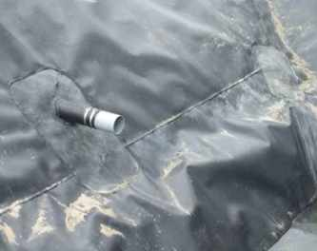
WATERTIGHT INSTALLATION OF UNDERDRAIN PIPES
To prevent leakages at the joint between the drainage pipes and the PE liner:
Welding/glueing and fix with brackets
Bitumen sealant

Slide 8
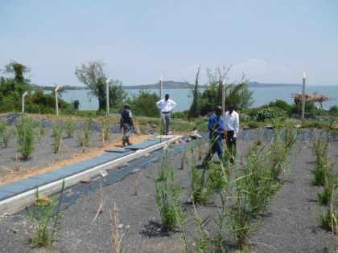
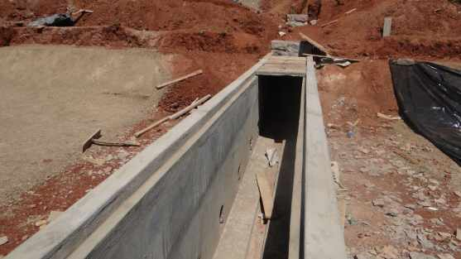
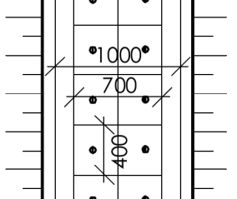
CENTRAL DRAINAGE CHANNEL
PCC (with steel frame) or iron cast cover with two handles per cover. Dimension: 700 x 400mm
Edge of the channel with recess

Slide 9
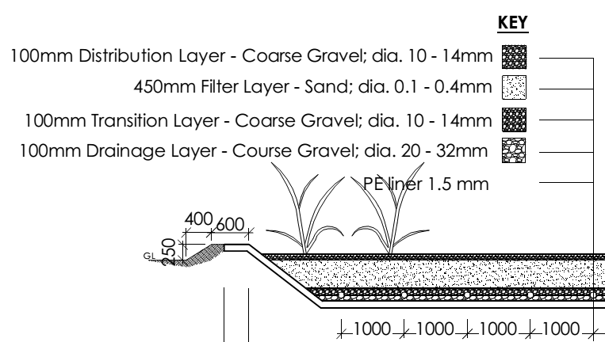
FILTER MEDIA
The gravel layers do not contribute to filtering process.
The middle sand layer is the actual filter bed.
Sand should be of uniform grain size: d10 between 0.1 and 0.4 mm
The sand filter bed should not contain loam, silt nor other fine material that could block the void
The gravel at the base should not have sharp edges
The layers of different size of substrate to be filled should be properly marked inside the basin

Slide 10
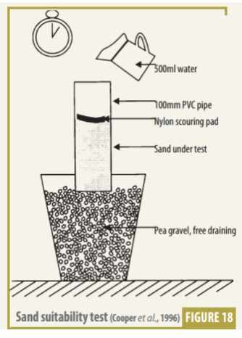
SAND SUITABILITY TEST
Place a 300 mm long length of 110 mm dia. PVC pipe on a bed of gravel for free draining
Fill it with 200 mm of the sand to be tested
Place a piece of scouring pad on top to reduce disturbance by the water
Pour 500 ml of water into the tube several time until the sand is completely damp (not saturated). The time for the water to drain from top to bottom should level off.
Sands that drain in 50 – 150 seconds for 500 ml (once saturated) are satisfactory.

Slide 11
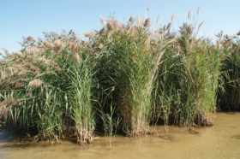
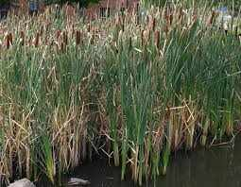
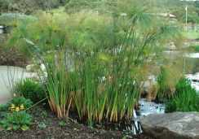
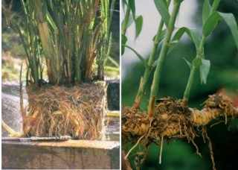
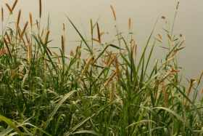
PLANTS
The plant chosen should follow the following criteria:
Indigenous (can be found locally)
Deep root penetration, strong rhizomes and massive fibrous root
Maximum surface area coverage (high biomass and stem density)
Common Reed
Overview of some possible plants:
Phragmis australis or Phragmites karka (Common Reed)
Typha latifolia or Typha angustifolia (Cattail)
Pennisetum purpureum (Elephant grass)
Cyperus papyrus (Papyrus sedge)
Cattail
Papyrus sedge
Root and rhizome system of reed
Elephant Grass

